Slide 1
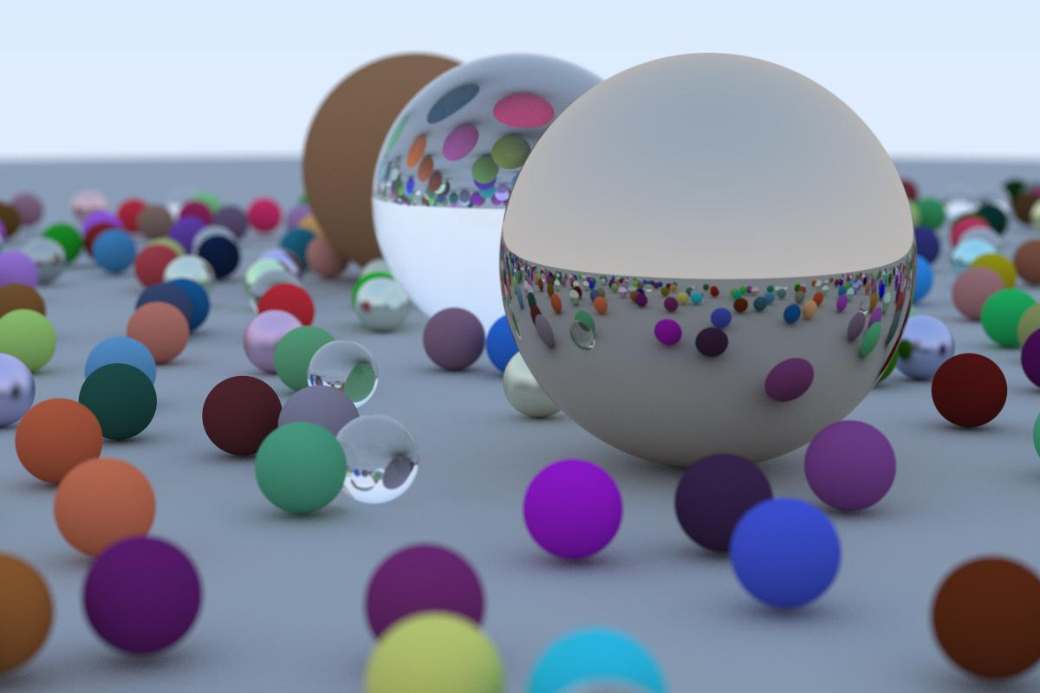
Parallelized Ray Tracing In One Weekend
組員:
吳俊宏 109550165
應耀德 311553007
賴奕廷 312551073

Slide 2
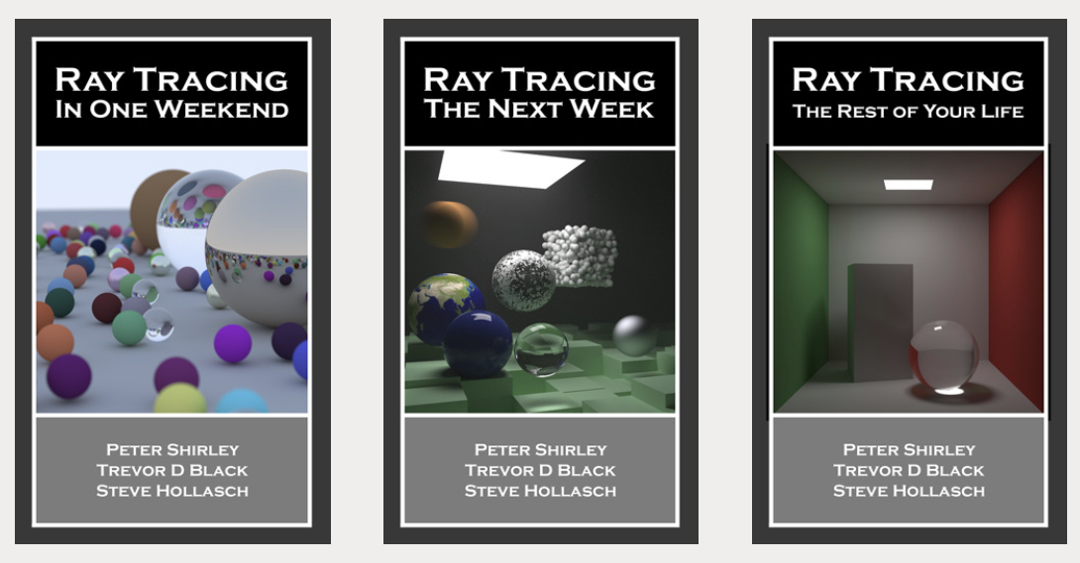
Ray Tracing in One Weekend Book Series
Introduction
https://raytracing.github.io/v3/books/RayTracingInOneWeekend.html

Slide 3
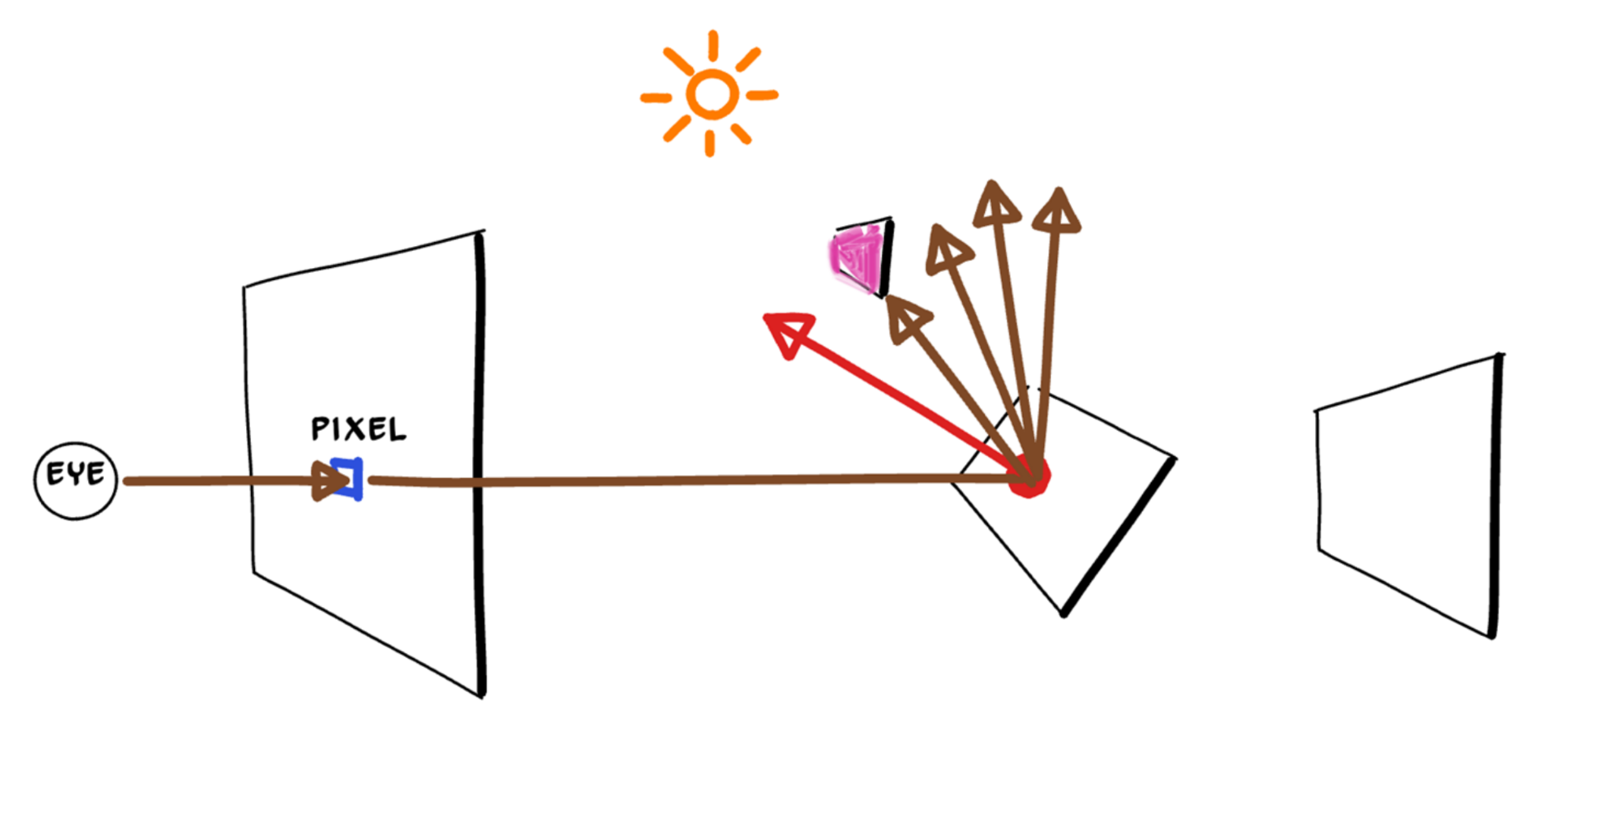
What Ray Tracing is Doing?
Introduction
Simulate the rays that comes into our eyes
Model various optical effects: reflection, refraction, scattering
McGuire, Shirley, and Wyman, Introduction to Real-Time Ray Tracing, 28 Jul 2019, SIGGRAPH'19 Courses

Slide 4
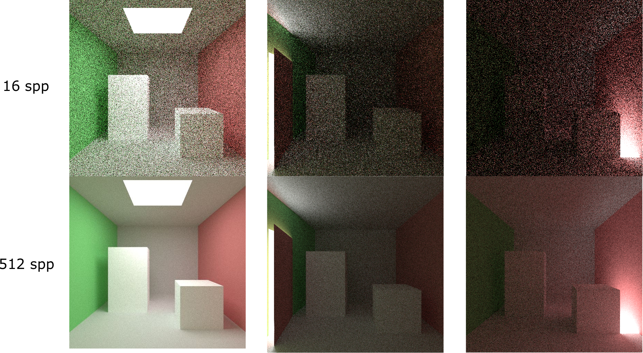
How Ray Tracing Works?
Introduction
Randomly sample N times from step 1 to 4 (Monte Carlo)
Calculate the ray from the eye to the pixel
Determine which object the ray intersects (closet one)
Keep scattering until max depths or not hitting (load balancing problem)
Aggregate the color of all intersection points
Average them
MONTE CARLO PATH TRACER: https://maurocomi.com/monteCarloPathTracer.html

Slide 5
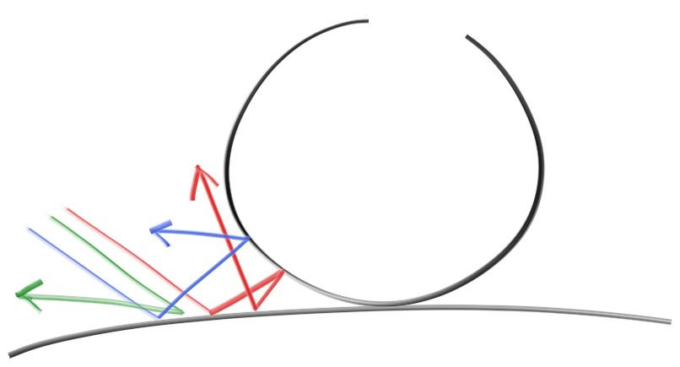
What’s the Problem?
Problem Statement
A ray may made multiple intersections since it scatters around
Computations on each pixels, e.g., 1,280 × 720 = 921,600
⇒ Very heavy workload!

Slide 6
Good News!
Problem Statement
Pixels are independent with each other

Slide 7
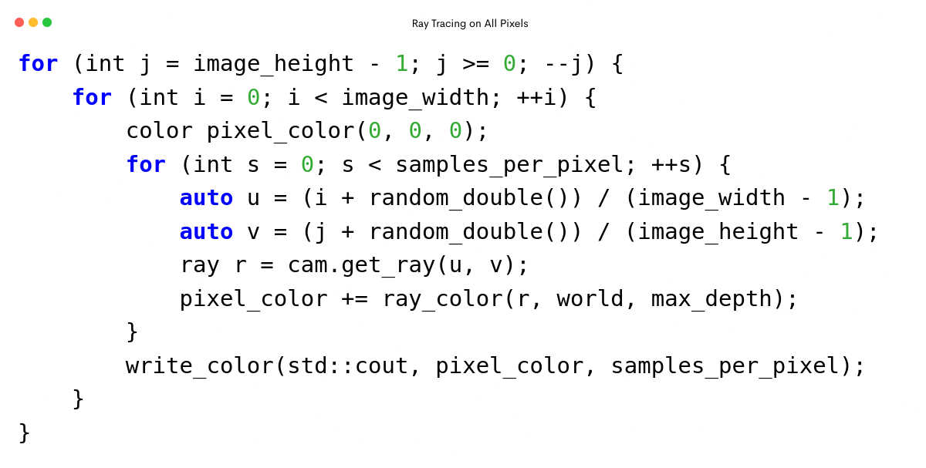
Problem Statement
Cannot parallelize!
https://codeimg.io/
Notes:
說明有一個雙層迴圈遍歷每個像素，其中有一個 write 是不能平行的
可以帶出最內圈似乎也有平行化的機會

Slide 8
Proposed solution
OpenMP
CUDA

Slide 9
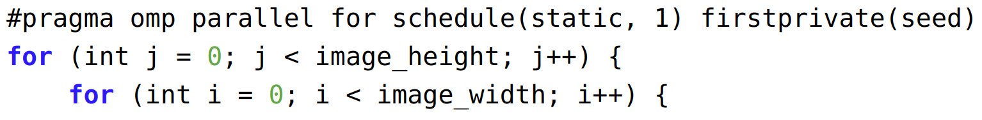
OpenMP
Proposed solution
Write each pixel to an array to eliminate the non parallelizable I/O.

Slide 10
CUDA
Proposed solution
CUDA device generates random number with curand_init. An independent random state is prepared for each thread.
The scene has to be initialized on the device since it cannot be easily copied.
It’s Undefined Behavior to pass as an argument to a __global__ function an object of a class with virtual functions since one cannot dispatch a function from device to host.
Recursive function causes stack overflow. The coloring function has to be converted into iterative form.
https://docs.nvidia.com/cuda/cuda-c-programming-guide/index.html#virtual-functions

Slide 11
What else? We try…
Proposed solution
Parallelize loop for sampling N times

Slide 12
Loop for sampling N times
Proposed solution

Slide 13
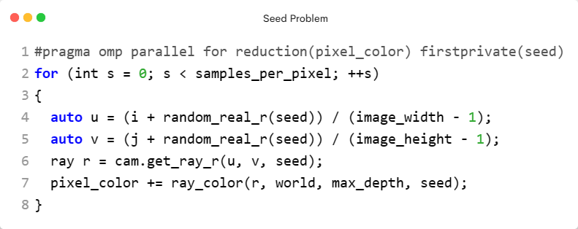
Loop for sampling N times
Proposed solution

Slide 14
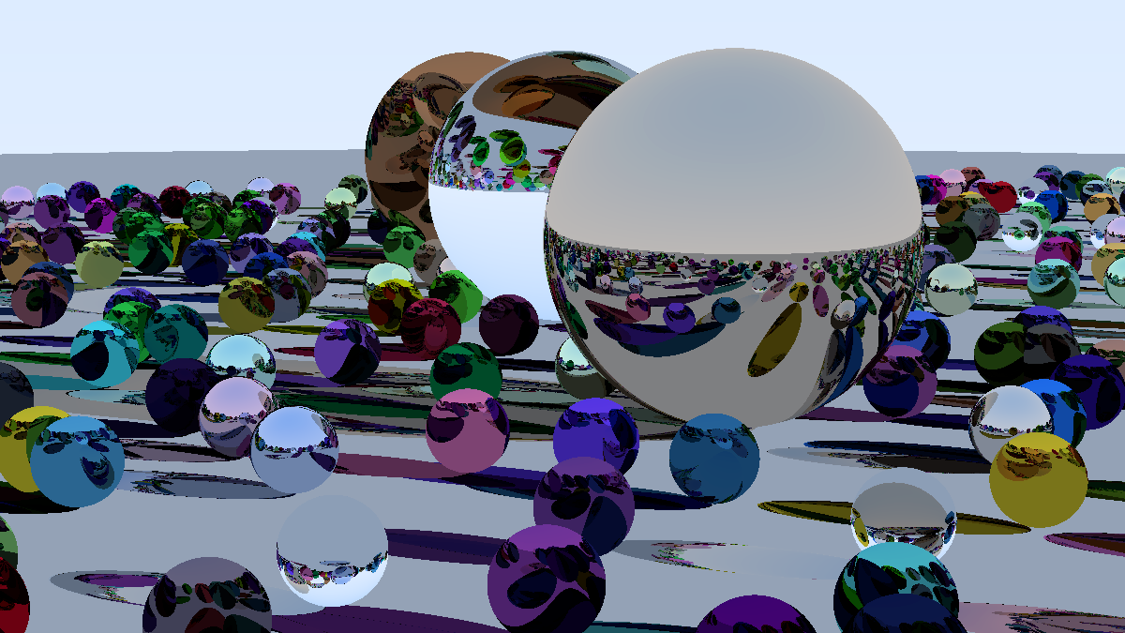
Loop for sampling N times
Proposed solution
Monte Carlo method requires enough randomness. The random sequence have to be kept.
⇒ Have loop dependency!
While firstprivate(seed) makes all samples have the same seed,
⇒ Cannot converge!
Notes:
converg

Slide 15
Platform
Hardware
CPU × 2 (NUMA node) | Intel(R) Xeon(R) Silver 4210 CPU @ 2.20GHz 10 cores 20 threads
GPU | NVIDIA RTX 2080Ti 12GB
RAM | 128GB
Software
OS | Ubuntu 22.04
Linux Kernel | 5.15.0-87-generic
OpenMP | 4.5
CUDA | 12.3
Container | Rootless Docker

Slide 16
Settings
Image size: 1200 x 675
Map size(# of objects): 22 x 22 = 484
Samples per pixel: 10
Max depth: 50

Slide 17
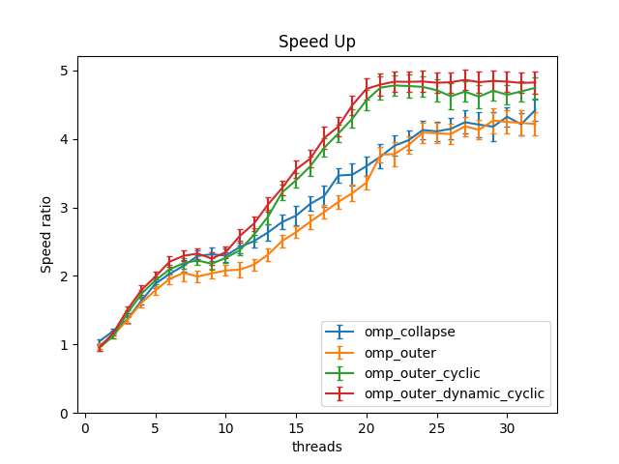
OpenMP
Evaluation
Best
CPU limitation
2 NUMA nodes (10 cores 20 threads) ⇒ communication overhead
Program
Load balancing problem
⇒ Outer loop + Dynamic scheduling + Cyclic partition is the best.

Slide 18
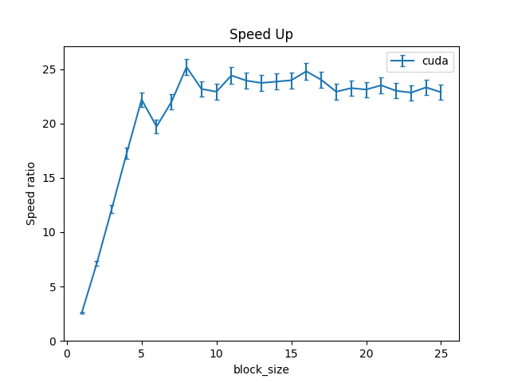
CUDA
Evaluation
Best
GPU limitation
65, 536 registers per SM
32 wraps per SM
Kernel function
Use 96 registers per thread
Can only use 20 wraps
Max occupancy of SM is 0.625
⇒ Block size 8 x 8 is the best.

Slide 19
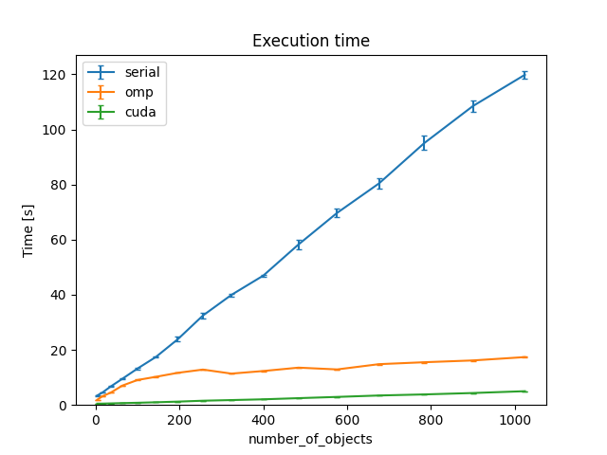
Map size (# of objects)
Evaluation
OpenMP
Use 22 threads
CUDA
Use 8 x 8 block size

Slide 20
Related work
Accelerated Ray Tracing in One Weekend in CUDA | NVIDIA Technical Blog
Ray Tracing in One Weekend Series
eduardohenriquearnold/raytracer: Ray Tracer implementation from scratch based on Peter Shirley's 'Ray tracing in one weekend' (github.com)

Slide 21
Contributions of each member
吳俊宏 109550165: OpenMP Implementation 33%
應耀德 311553007: Support + Profiling + Benchmark 33%
賴奕廷 312551073: CUDA Implementation 33%

Slide 22
Conclusion
The maximum speed up of OpenMP over the serial program is ~5x.
The maximum speed up of CUDA over the serial program is ~25x.
Appropriate load balancing can be 1.25x faster in comparison with the imbalance one.
Monte Carlo method relies on the proper random sequence, thus the sampling cannot be further parallelized.

Slide 23
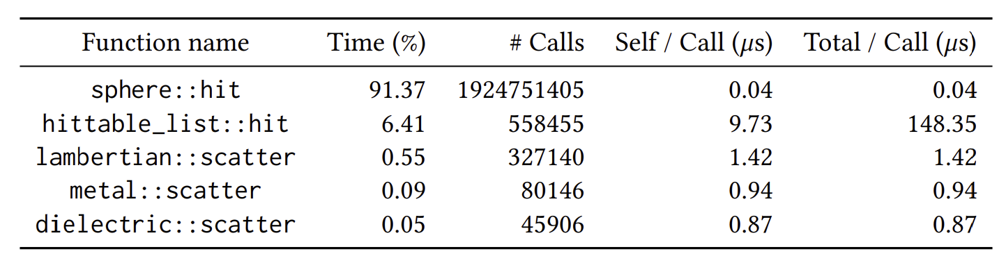
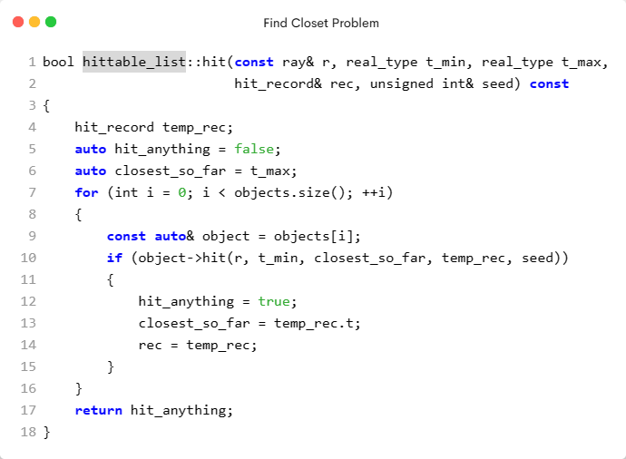
Future work
Parallelizing finding the closest object
Need nested parallelization
Require more CPU cores
⇒ OpenMP with NUMA nodes ⇒ CUDA with Dynamic Parallelism

Slide 24
End

Slide 25
Finding the closet intersected objects

Slide 26
Finding the closet intersected objects
What’s the problem?
Finding the closet
Loop dependency

Slide 27
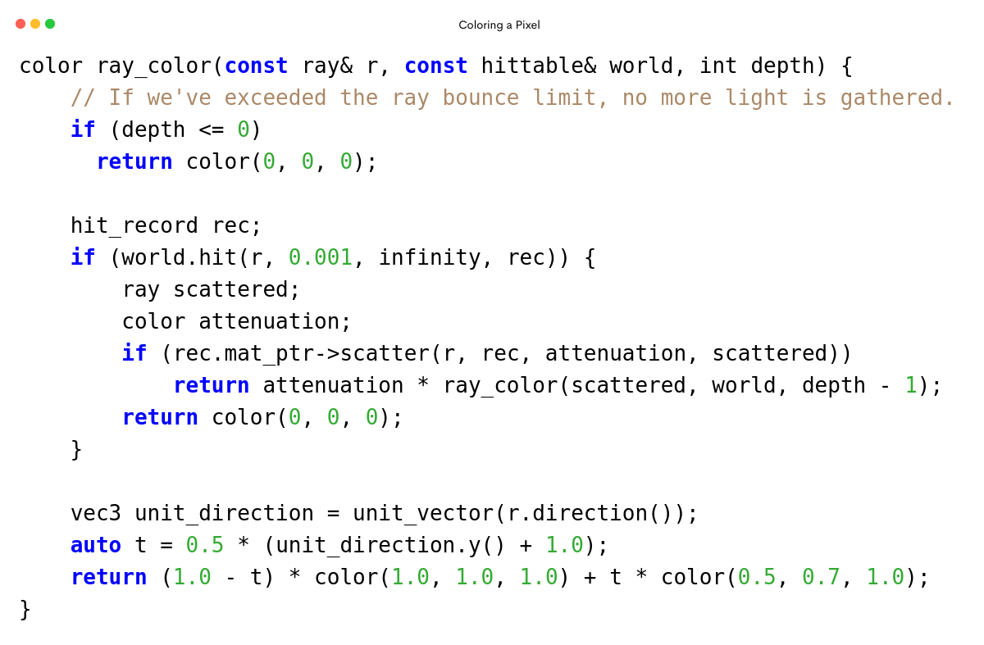
Introduction
Recursive call; at most depth times.
⇒ Opportunity of Load Balancing.

Slide 28
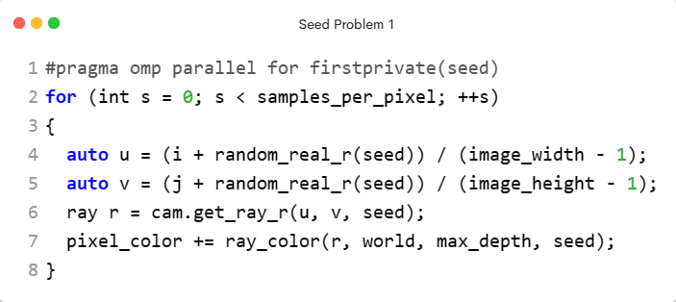
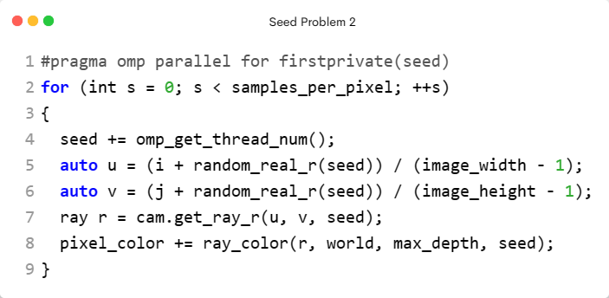
Loop for sampling N times

Slide 29
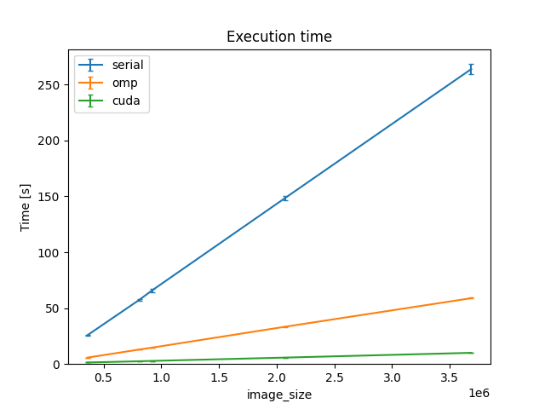
Image size (16:9)
Evaluation
OpenMP
Use 22 threads
CUDA
Use 8 x 8 block size

